Slide 1
Predicting Home Prices in Ames, Iowa: Machine Learning for Real Estate
To Fit or Not to Fit?

Slide 2


Background
The Ames Housing dataset is a widely used benchmark in the field of machine learning for real estate valuation. Compiled by Dr. Dean De Cock in 2011, it offers a rich resource for analyzing factors influencing single-family home prices in Ames, Iowa.
Snapshot of the housing market during the mid-2000s, between 2006 and 2010.
Reveals how location and size characteristics influence housing prices.
Features like overall quality, number of bedrooms/bathrooms, and presence of amenities like fireplace or central air, provide insights into what buyers valued in Ames.

Slide 3

Problem Statement
Develop a machine learning model that accurately predicts the sale price of single-family homes in Ames, Iowa. Predictive modeling with regression is a valuable tool for real estate professionals and homeowners in the area.
Success Evaluation:
Accuracy: a low Root Mean Squared Error (RMSE), indicates the model's ability to predict sale prices close to the true values.

Slide 4
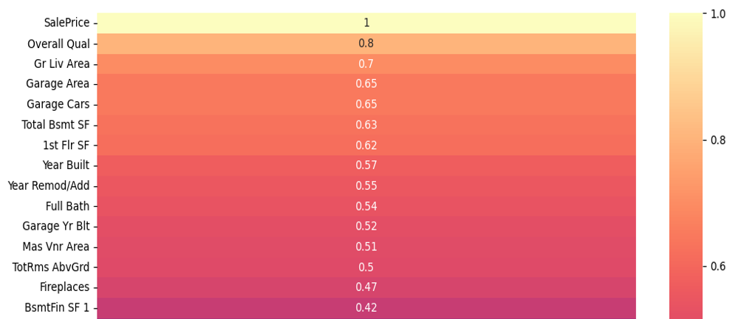
Numerical Data
Correlation Coefficient:
Sorted by strength.
Use the top numerical features for modeling.
Plot graphs of features that are relevant in readable heatmap.
Models (Candidates):
Multilinear Regression
Ridge Regression
Lasso Regression
ElasticNet Regression

Slide 5
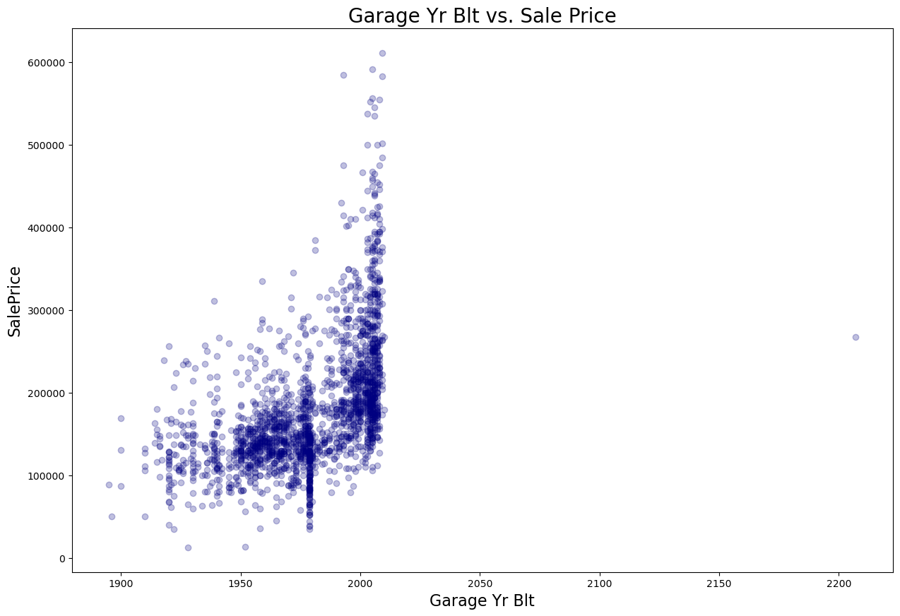

Feature Engineering
Creating meaningful from the available data is a critical step in the machine learning process. We will explore the techniques used for feature engineering to enhance the accuracy of our predictive models.

Slide 6
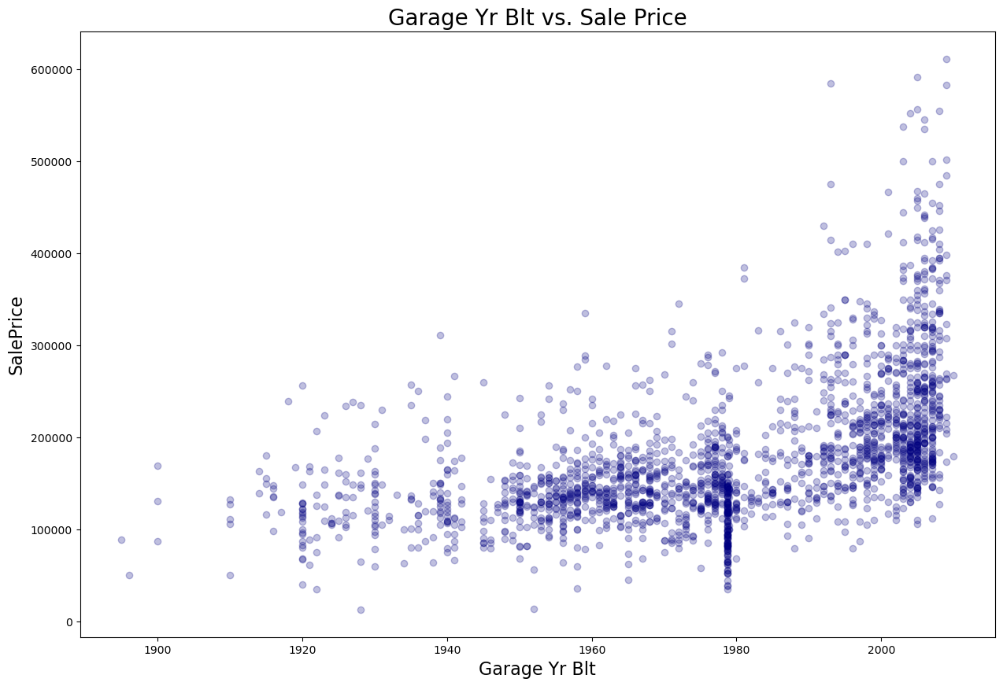
Feature Engineering
Creating meaningful from the available data is a critical step in the machine learning process. We will explore the techniques used for feature engineering to enhance the accuracy of our predictive models.

Slide 7
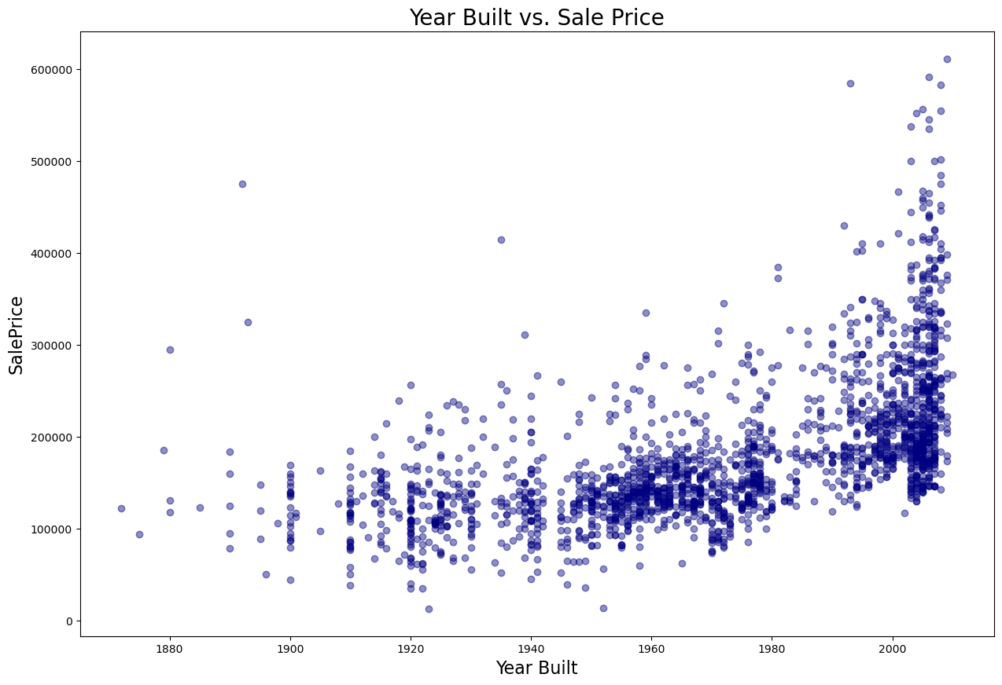
Feature Engineering
Creating meaningful from the available data is a critical step in the machine learning process. We will explore the techniques used for feature engineering to enhance the accuracy of our predictive models.

Slide 8
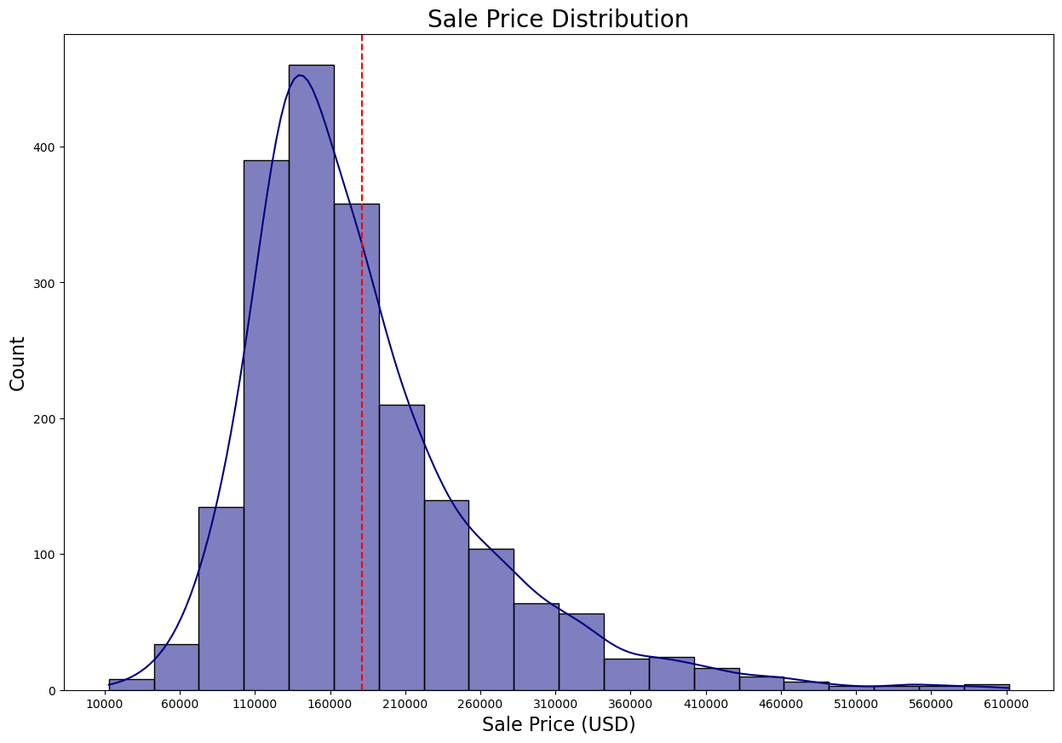
Feature Engineering
Creating meaningful from the available data is a critical step in the machine learning process. We will explore the techniques used for feature engineering to enhance the accuracy of our predictive models.

Slide 9
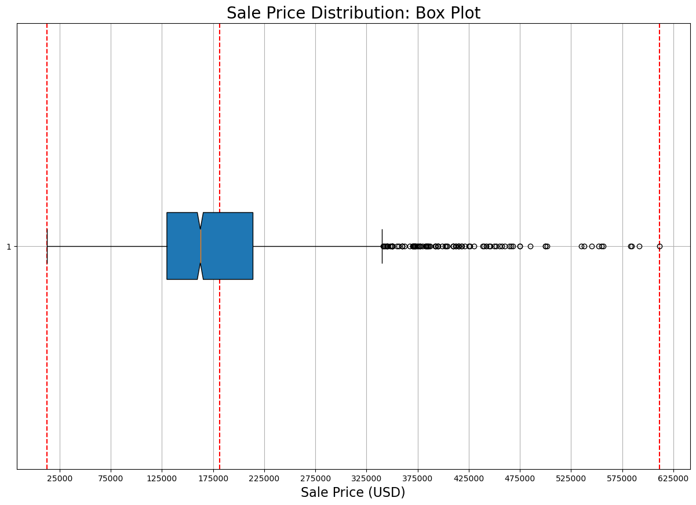
Feature Engineering
Creating meaningful from the available data is a critical step in the machine learning process. We will explore the techniques used for feature engineering to enhance the accuracy of our predictive models.

Slide 10

Model Training
From the four candidates, Lasso Regression ends up as the best model at predicting Sale Price values. Let’s look at relevant points on this modeling technique:
Accuracy: Lasso minimizes the errors between predicted and actual prices. This ensures your model makes good predictions. (Think of it as real estate agent getting the ballpark price right.)
Feature Selection: Unlike regular regression, Lasso adds “shrinkage” penalty. It can push some coefficients to zero, effectively removing them from the model. (Think of the agent focusing only on crucial aspects like size and location.)
Trade-off: Lasso might eliminate a relevant factor if it's weakly correlated with other features. Compare Lasso with other models like Ridge Regression, which shrinks coefficients but doesn't eliminate them, can be valuable.

Slide 11
Model Evaluation: Test Metrics
Metric (ElasticNet) | Value
R - Squared | 0.8504101451655979
Mean Absolute Error | 20665.268367674693
Median Absolute Error | 13833.485296685321
Mean Squared Error | 888790440.2236749
Root Mean Squared Error | 29812.588619971848
R Squared (0.85): Imagine hitting a bullseye on a dartboard. An R-squared of 0.85 means the Lasso model is landing 85% of its predictions close to the center!
Mean/Median Absolute Error ($20,665/$13,833): Think of this as the average difference between the predicted price and the actual price. A lower number means your predictions are typically within a few ten thousand dollars of the real value.
Root Mean Squared Error ($29,813): For each house, calculate the difference between predicted price and actual price. Square those differences (account for negative errors), take average of those squared values, and finally take the square root. RMSE of $29,813 tells us that on average, the predictions are off by about $30,000 from the actual prices.

Slide 12
Model Evaluation: Test Metrics
Metric (Linear) | Value
R - Squared | 0.8871324703612562
Mean Absolute Error | 19059.089077633616
Median Absolute Error | 14680.672247606039
Mean Squared Error | 670604176.1029077
Root Mean Squared Error | 25896.026260855306
Metric (Ridge) | Value
R - Squared | 0.8872678653805913
Mean Absolute Error | 19033.69638362567
Median Absolute Error | 14572.504790880485
Mean Squared Error | 669799724.4977359
Root Mean Squared Error | 25880.489263105825
Metric (Lasso) | Value
R - Squared | 0.8874283150793292
Mean Absolute Error | 19039.356262231824
Median Absolute Error | 14552.458647036576
Mean Squared Error | 668846410.1266992
Root Mean Squared Error | 25862.06507854118

Slide 13
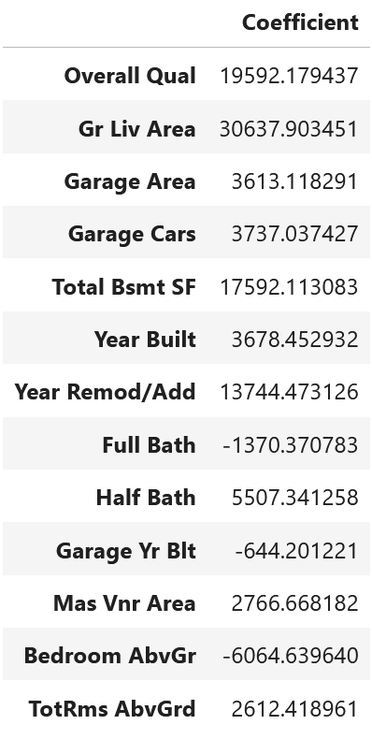
Predictive Insights
Here are some interesting conclusions from the lasso coefficients listed in the DataFrame:
holding all else constant, for every one car increase in Garage Cars, expect the Sale Price to increase by about $3,740.
holding all else constant, for every one year increase in Year Built, expect the Sale Price to increase by about $3,680.
holding all else constant, for every increase in value by 1, in Overall Quality, expect the Sale Price to increase by about $19,590.

Slide 14

Conclusion
Lasso Regression Model gives the lowest RMSE of 25862.065! Expect the Kaggle Score to be different on the leaderboards.
From the looks of it, this might generalize quite well on Kaggle’s new test data.
Kaggle Challenge: (Late Submission)
Public Score - 27447.39733
Private Score – 29633.40227
Limitations:
Did not use any dummy variables in modelling process.
No function to find optimal alpha for ridge or lasso.

Slide 15
Citations
De Cock, Dean. (2011). Ames Housing Dataset. www.kaggle.com/datasets/marcopale/housing
Wickham, H., & Grothmann, C. (2016). Tidy Modeling with R www.tmwr.org/ames
Tan, Alvin T., PhD. (2022). Cracking the Ames Housing Dataset With Linear Regression. www.towardsdatascience.com/wrangling-through-dataland-modeling-house-prices-in-ames-iowa-75b9b4086c96

